Slide 1
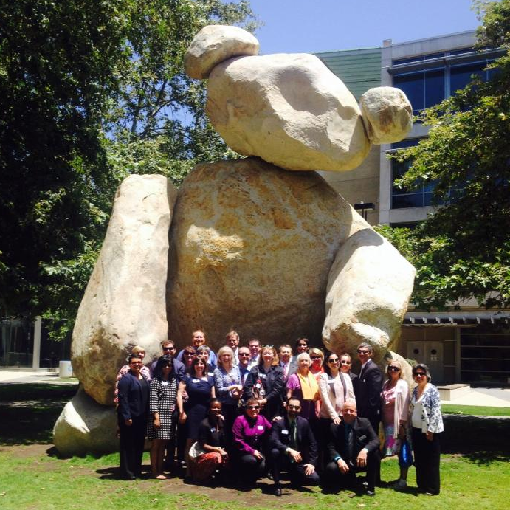
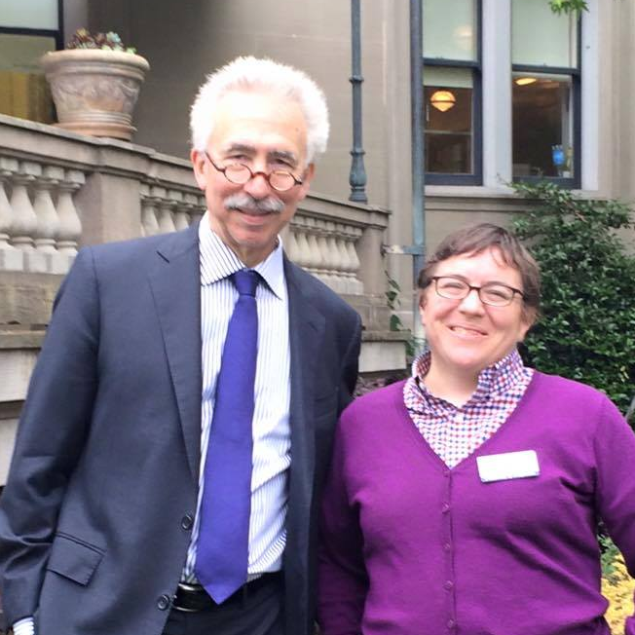
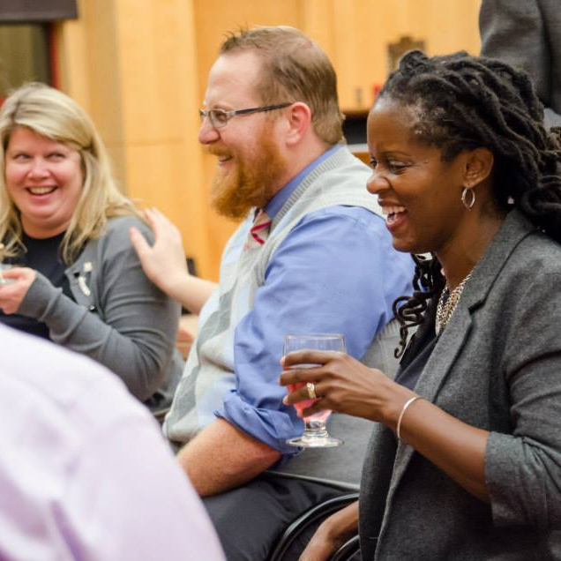
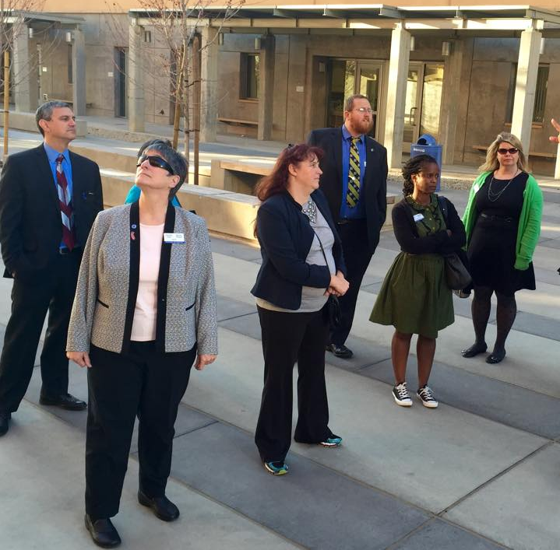
Berkeley | Berkeley Lab | Davis | Irvine | Los Angeles | Merced | Office of the President | Riverside | Santa Barbara | Santa Cruz | San Diego | San Francisco
Notes:
Lina

Slide 2
Berkeley | Berkeley Lab | Davis | Irvine | Los Angeles | Merced | Office of the President | Riverside | Santa Barbara | Santa Cruz | San Diego | San Francisco
Notes:
Lina

